Slide 1


SOME ANALYSIS ON THE ANOMALIES OCCURING DURING ENTRY IN MARTIAN ATMOSPHERE
Candidate Name: SOLOMON JEANAUSTIN
Academic Year : 2019-2022
Matricola: 1889683
Course: Ph.D in Energy and Environment
Cycle: XXXV
Supervisors: 1. Prof. Paolo Teofilatto
2. Prof. Antonella Ingenito

Slide 2
Goal of the thesis
To perform an analysis of the Schiaparelli mission, reproducing the different re-entry phases to eventually understand the reasons of the mission failure by using CFD analysis of the capsule and parachute during the entry phase into the Mars atmosphere.
simulate the Schiaparelli environment conditions considering the composition of the Mars atmosphere and the nominal entry conditions of the capsule with chemical reactions.
simulate the wake after the capsule
→ this represents the flow encountered by the parachute during its deploying phase which is to be analysed considering approximated analytical modes as well as by numerical investigation with ideal gas.
→ perform numerical investigation of the aereal oscillations and final trajectory of the Schiaparelli Parachute deployment with various angles of attack using chemical components in Martian atmosphere.

Slide 3
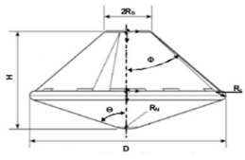
DESCRIPTION OF SCHIAPPARELLI MISSION
ExoMars contains two missions:
1.TGO with Schiapparelli EDM launcher (which was launched on March 2016).
2. Rover (which was planned for launching in 2022 but it was suspended due to Russia's invasion of Ukraine).
On Oct 2016,TGO delivered Schiapparelli ballistic flight path towards mars which was failed at terminal part descent and crashed in Martian surface.
Schiaparelli was a re-entry capsule used in the framework of the ESA ExoMars mission and had a serious anomaly during the descending phase and was destroyed at the impact on the Martian Surface.
The failure was generated by unexpected oscillations of the parachute occurring during the parachute deployment (a phenomenon called areal oscillations): these fast oscillations saturated the gyro sensors so that attitude of the capsule was wrongly determined, and the on-board computer gave wrong recovery commands.
Mass of the Vehicle = 577 kg (after separation) and 280 kg (at landing)
Front Shield Cone angle(ϴ) = 70°
Back Shield Cone Angle(Ф) = 47°
Front (FS) and Back Shield (BS) Diameter = 2.4 m
Capsule Height = 1.276 m
Blunt End(nose) Radius = 0.6 m
Base radius = 0.3 m
Corner radius = 6 m
Material Of the Capsule : Aluminium sandwich (with carbon filter reinforced polymer material)

Slide 4
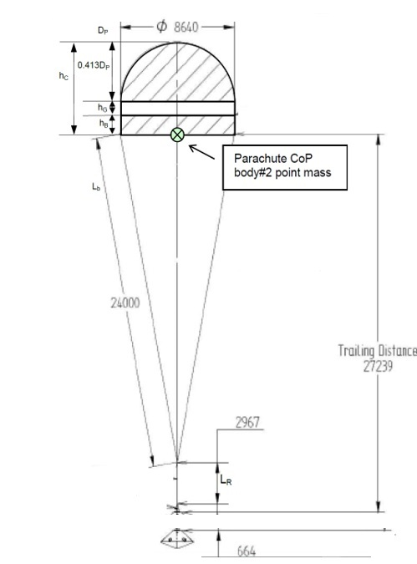
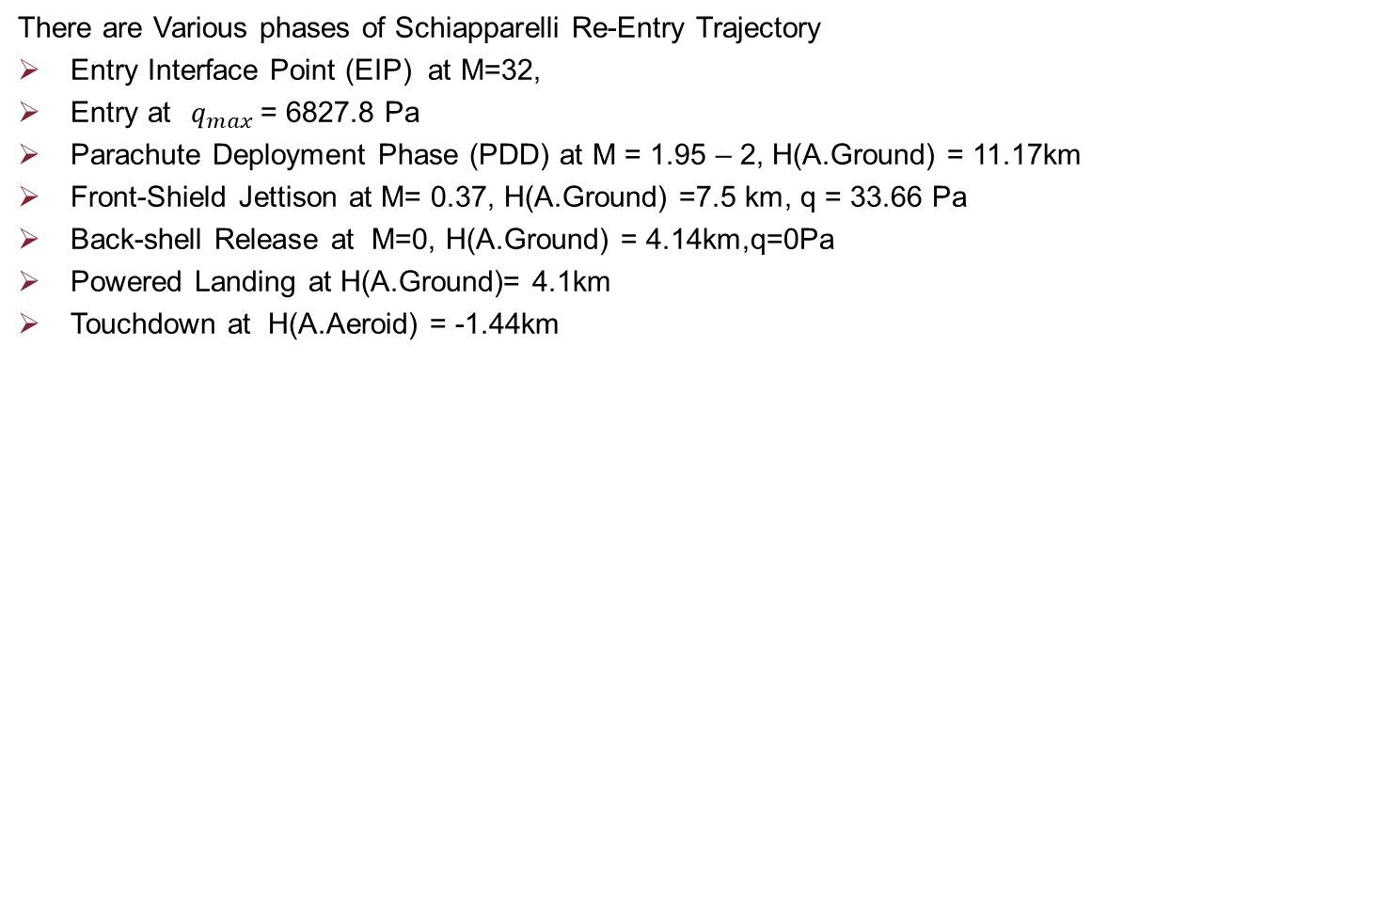
There are Various phases of Schiapparelli Re-Entry Trajectory
Entry Interface Point (EIP) at M=32,
Entry at$q_{max}⁡$= 6827.8 Pa
Parachute Deployment Phase (PDD) at M = 1.95 – 2, H(A.Ground) = 11.17km
Front-Shield Jettison at M= 0.37, H(A.Ground) =7.5 km, q = 33.66 Pa
Back-shell Release at M=0, H(A.Ground) = 4.14km,q=0Pa
Powered Landing at H(A.Ground)= 4.1km
Touchdown at H(A.Aeroid) = -1.44km
Parameter | Symbol | Value
Nominal Diameter | D₀ | 12.000m
Nominal Area | S₀ | 113.097m²
Projected Diameter | D_{P} | 8.640m
Disk Diameter | D_{D} | 8.223m
Gap Height | h_{G} | 0.957m
Band Height | h_{B} | 1.357m
Vent Diameter | D_{v} | 0.848m
Line Length | L_{s} | 24.0m
Riser Length | L_{R} | 2.967m
Bridle Length | L_{b} | 0.688m
Bridle height | h_{b} | 0.664m
Bridle Attachment PCD | b | 0.356m
Distance between parachute and capsule | L | 27.631m
Material of parachute : DGB woven with nylon fiber

Slide 5
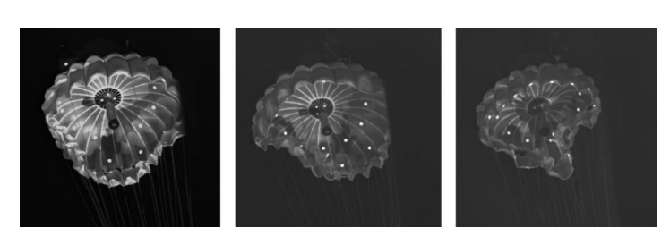
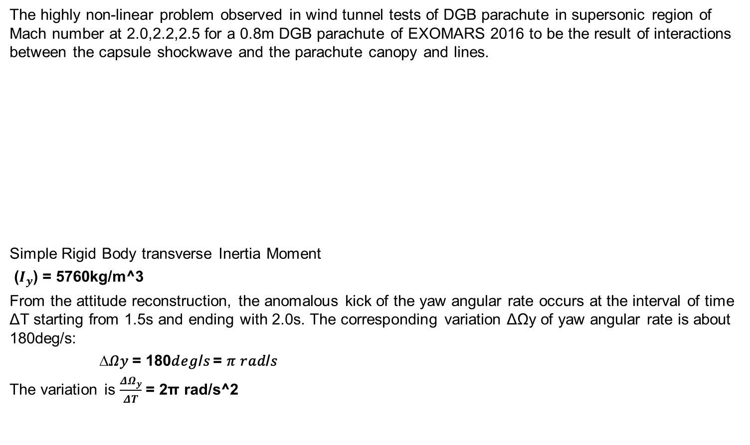
THE FAILURE DUE TO AREAL OSCILLATIONS
The highly non-linear problem observed in wind tunnel tests of DGB parachute in supersonic region of Mach number at 2.0,2.2,2.5 for a 0.8m DGB parachute of EXOMARS 2016 to be the result of interactions between the capsule shockwave and the parachute canopy and lines.
Simple Rigid Body transverse Inertia Moment
($I_{y}$) = 5760kg/m^3
From the attitude reconstruction, the anomalous kick of the yaw angular rate occurs at the interval of time ΔT starting from 1.5s and ending with 2.0s. The corresponding variation ΔΩy of yaw angular rate is about 180deg/s:
∆𝛺𝑦 = 180𝑑𝑒𝑔/𝑠 = 𝜋 𝑟𝑎𝑑/𝑠
The variation is $\frac{{ΔΩ}_{y}}{ΔT}$ = 2π rad/s^2
M = 2.0
M = 2.2
M = 2.5

Slide 6
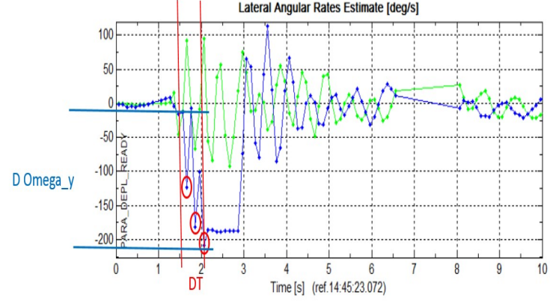
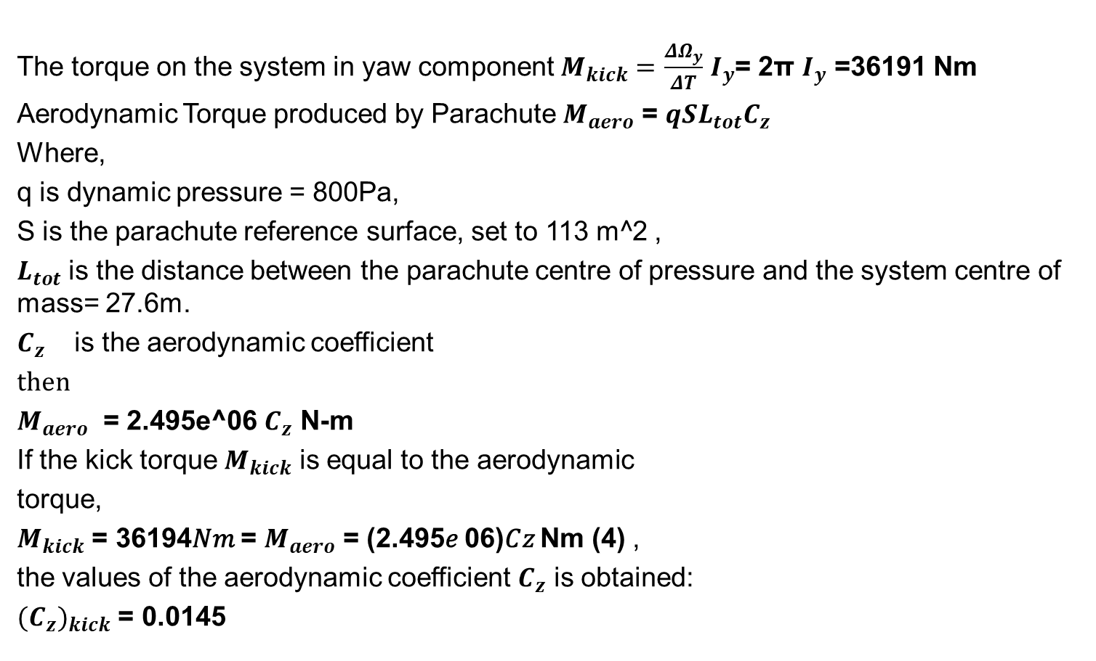
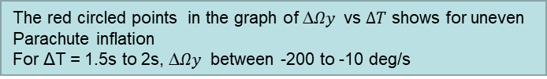
The torque on the system in yaw component $M_{kick}=$ $\frac{{ΔΩ}_{y}}{ΔT}$ $I_{y}$= 2π $I_{y}$ =36191 Nm
Aerodynamic Torque produced by Parachute $M_{aero}$ = ${qSL}_{tot}C_{z}$
Where,
q is dynamic pressure = 800Pa,
S is the parachute reference surface, set to 113 m^2 ,
$L_{tot}$ is the distance between the parachute centre of pressure and the system centre of mass= 27.6m.
$C_{z}$ is the aerodynamic coefficient
then
$M_{aero}$ = 2.495e^06 $C_{z}$ N-m
If the kick torque $M_{kick}$ is equal to the aerodynamic
torque,
$M_{kick}$ = 36194𝑁𝑚 = $M_{aero}$ = (2.495𝑒 06)𝐶𝑧 Nm (4) ,
the values of the aerodynamic coefficient $C_{z}$ is obtained:
${{(C}_{z})}_{kick}$ = 0.0145
The red circled points in the graph of ∆𝛺𝑦 vs $∆T$ shows for uneven
Parachute inflation
For ΔT = 1.5s to 2s, ∆𝛺𝑦 between -200 to -10 deg/s

Slide 7
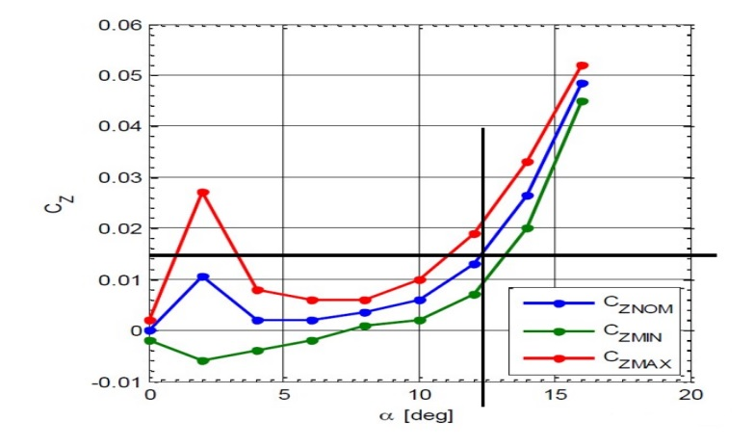
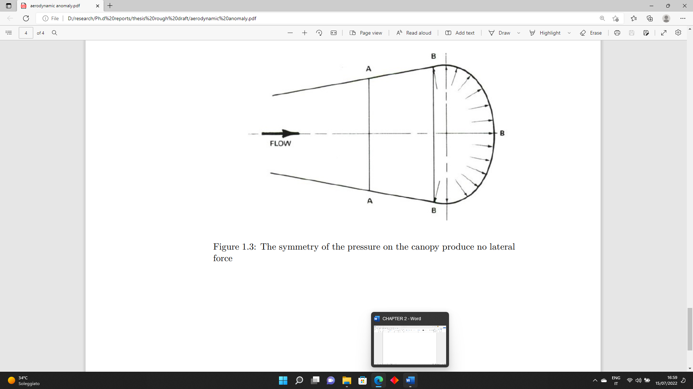
For angle of attack α < 12deg the nominal 𝐶𝑧 coefficient is below the value of (𝐶𝑧)𝑘𝑖𝑐𝑘 , and the maximum 𝐶𝑧 exceeds the value (𝐶𝑧)𝑘𝑖𝑐𝑘 for α in the range of 0 to1deg, 5-16deg .There is a decrease in the value (𝐶𝑧)𝑘𝑖𝑐𝑘 for α in the range of 2deg to 4 deg.
symmetry of the aerodynamic pressure on the canopy produces no lateral force.
Investigate the pressure flow field for the Schiapparelli capsule and Canopy

Slide 8
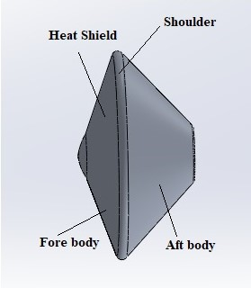
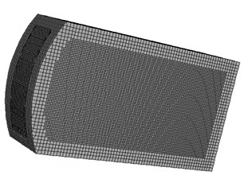
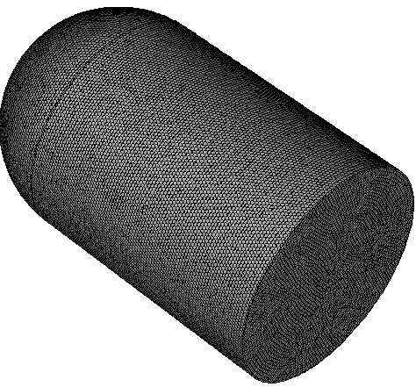
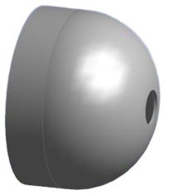
THE WAKE AND PARACHUTE DYNAMICS
Boundary conditions
Zone | Type | Parameters
Inlet | Pressure Far field | At H=10km, M=2.04 (Velocity (v)=228.5m/s) P=250Pa T=205K At H=20km, M=2.14, P= 95.04 Pa T=188.3 K At H=50 km, M=2.38, P= 3.1545e-02 Pa T=152.2 K For chemical composition, Species transport Mass fractions: CO₂ = 0.9532 O₂ = 0.00174 N₂ = 0.0028 CO = 0.000747 H₂O = 0.0003 Ar =0.0017
Wall | Wall | -
Meshing: cut-cell method (for Structured mesh)
No of cells: 1.17 million
Domain length = 100m
Schiapparelli EDM Capsule Design
Design of the parachute of Schiapparelli EDM
Meshing: Polyhedral (for Structured mesh)
No of cells: 1.13 million
Domain length = 100m

Slide 9
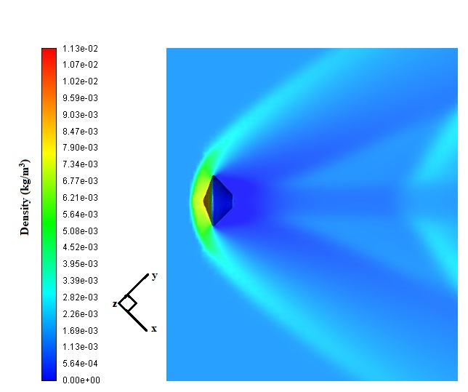
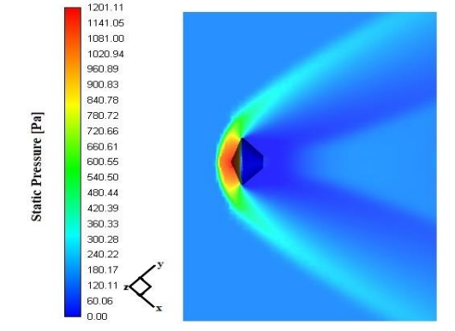
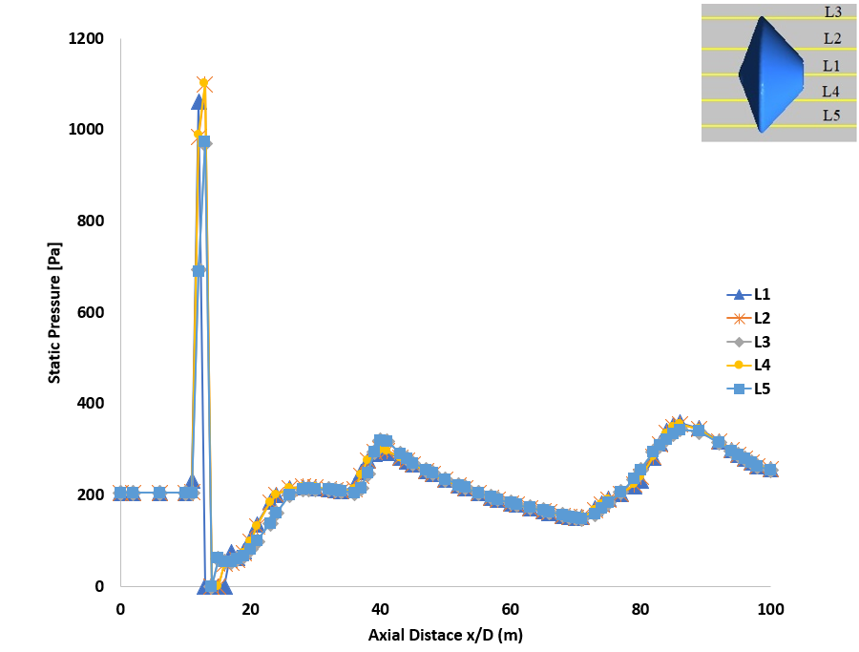
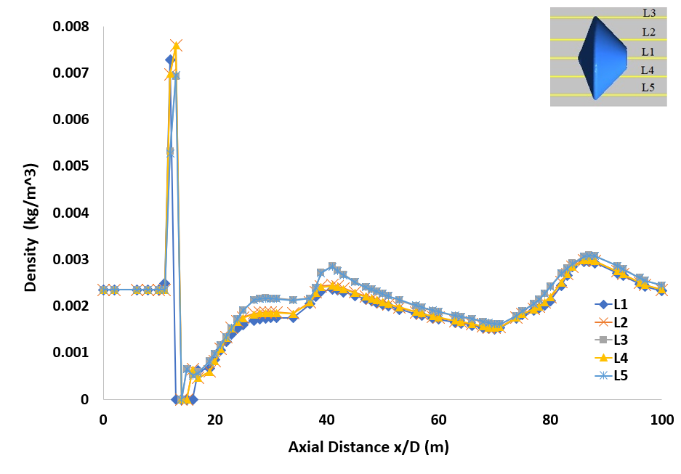
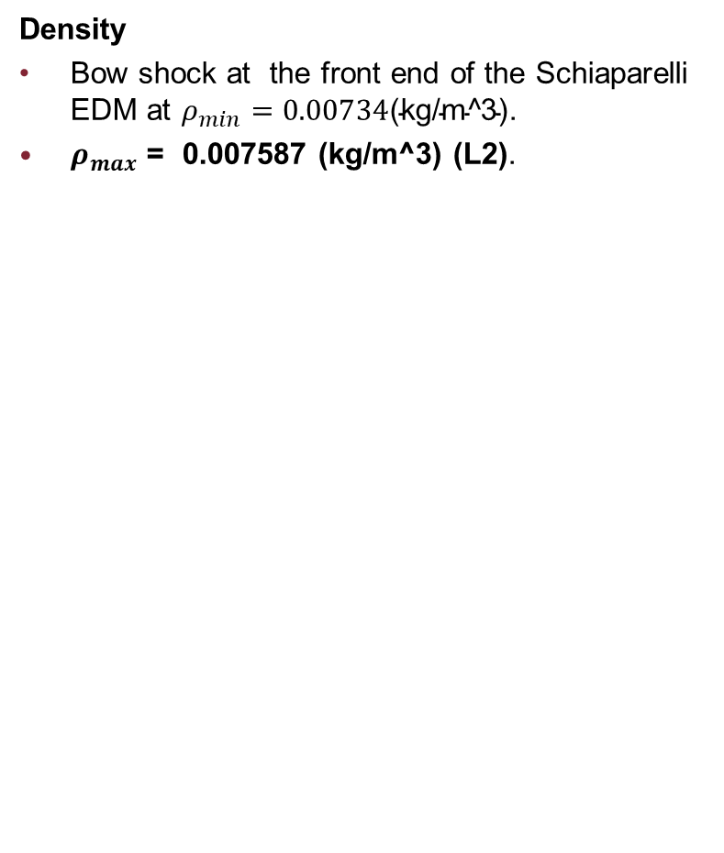
SCHIAPPARELLI CAPSULE AT α=0°M=2.04185, H = 10km
Pressure
Strong bow shock at the front end of the Schiaparelli EDM
Immediate drop at the leeside of the aft body.
Pmax= 1201.11 Pa ( observed from contour),Pmax = 1101.57 Pa(L4), Pmax = 982.15 Pa (L1).
Density
Bow shock at the front end of the Schiaparelli EDM at $ρ_{min}=0.00734\text{(}\text{kg}\text{/}\text{m}\text{^3)}$.
$ρ_{max}$ = 0.007587 (kg/m^3) (L2).

Slide 10
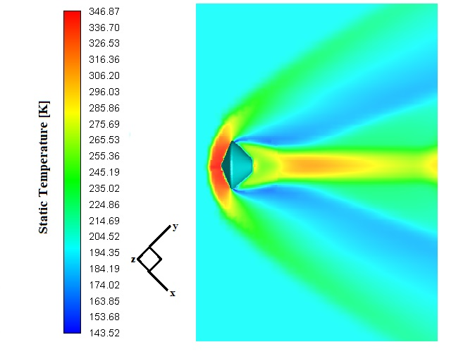
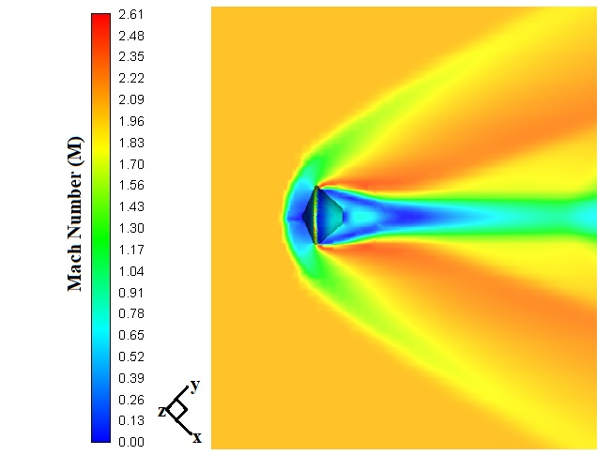
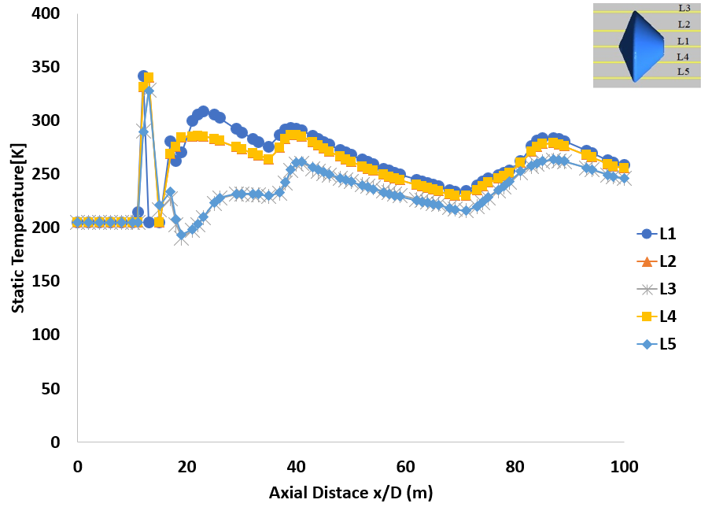
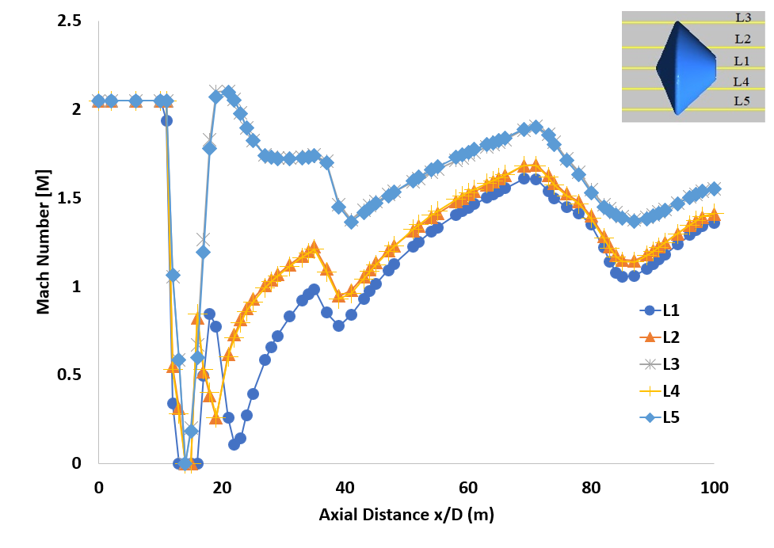
Temperature
Wider bow shock at front end of the capsule.
Narrower shock layer at rear end of the capsule.
Tmax= 346.87K.
Mach number
Bow shock wave at the1.5m from front end of the Schiaparelli EDM.
Wider shock waves at lee side.

Slide 11
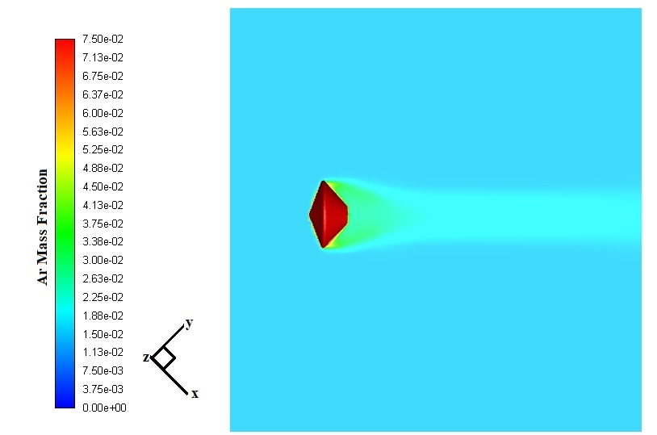
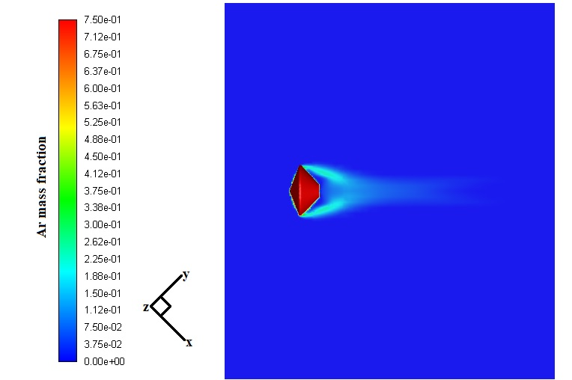
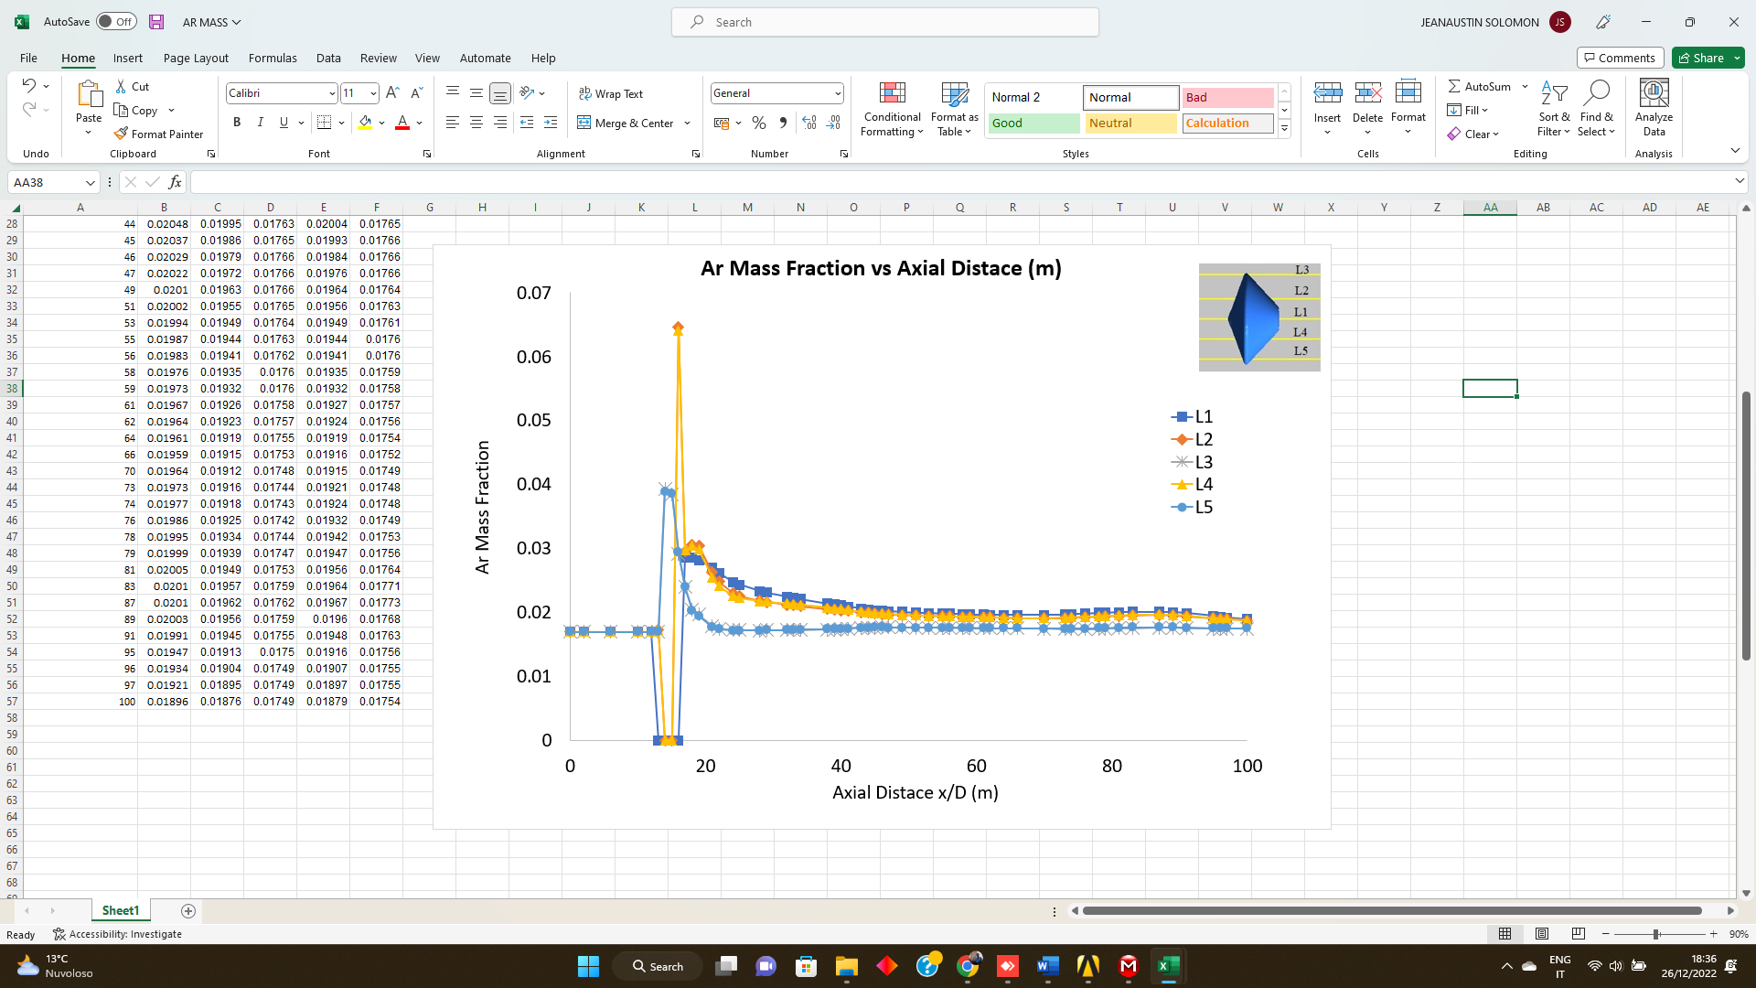
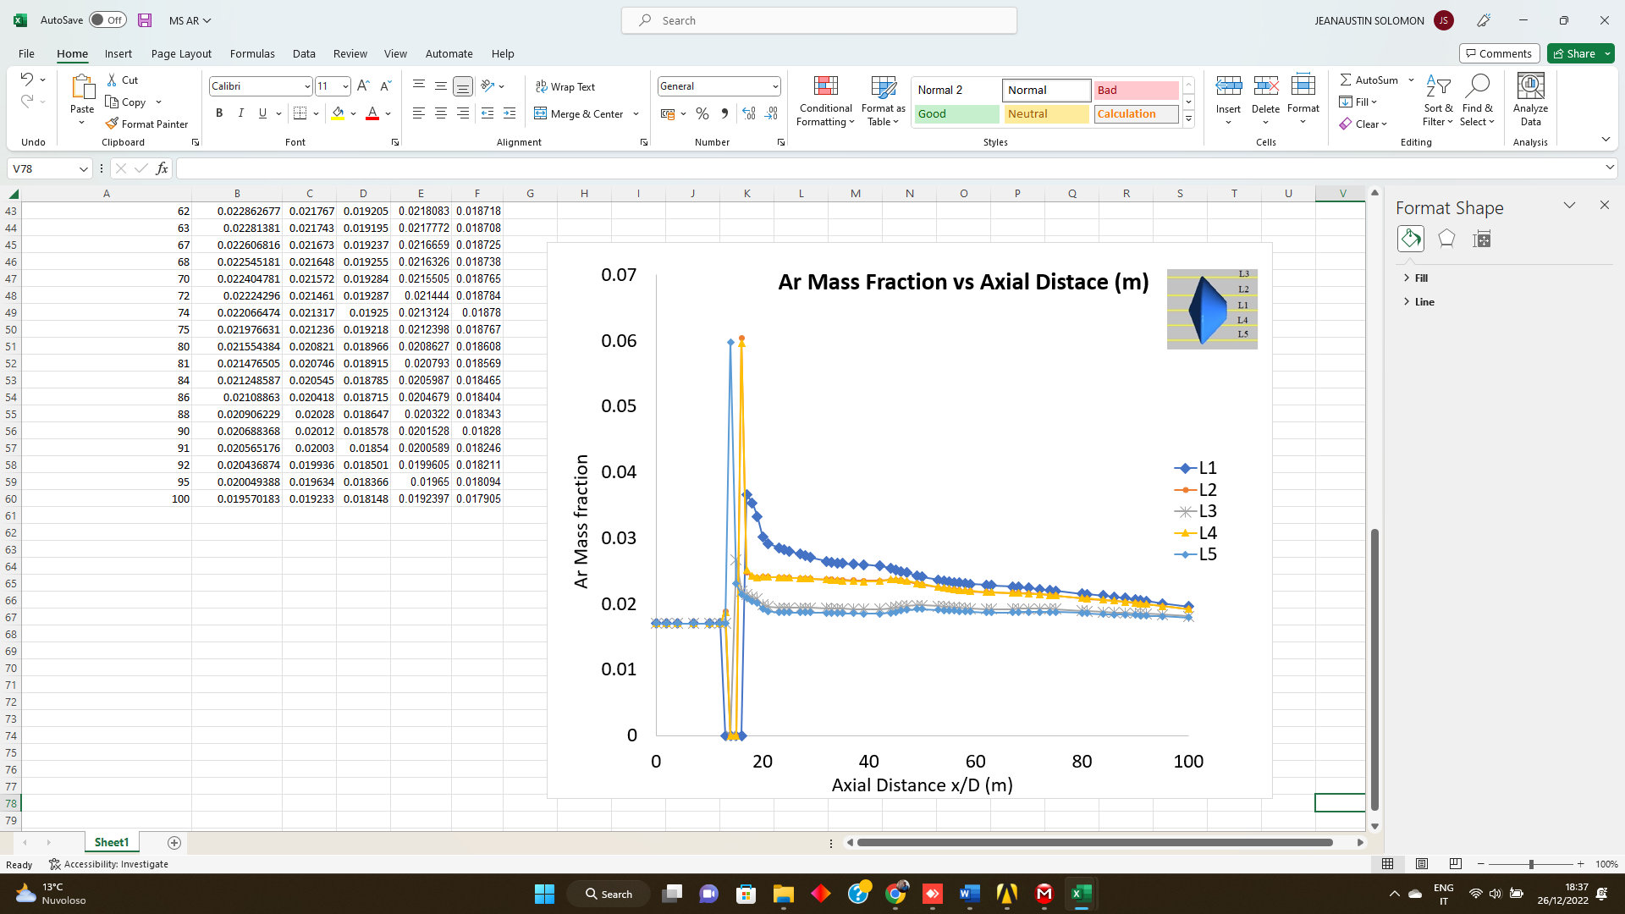
SCHIAPPARELLI CAPSULE AT α =0°AT REAL GAS
Mass fraction of Ar at H = 20km
Shockwave from sidewalls of the capsule.
Narrower shockwave at rear end.
Max Ar Mass frac is 0.065
Mass fraction of Ar at H = 50km
Powerful shockwave from sides of the capsule to rear body.

Slide 12
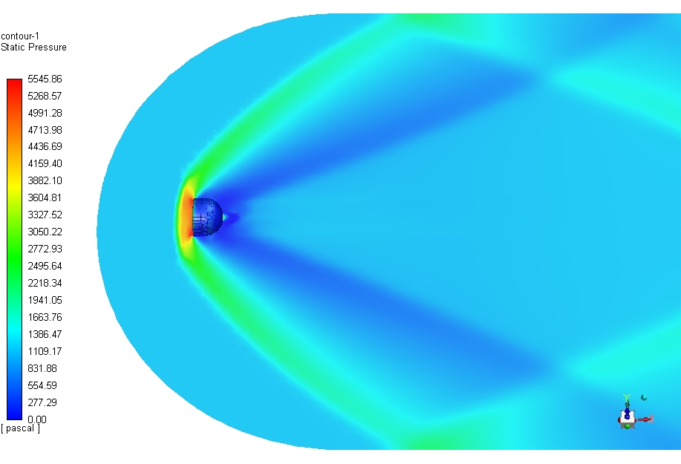
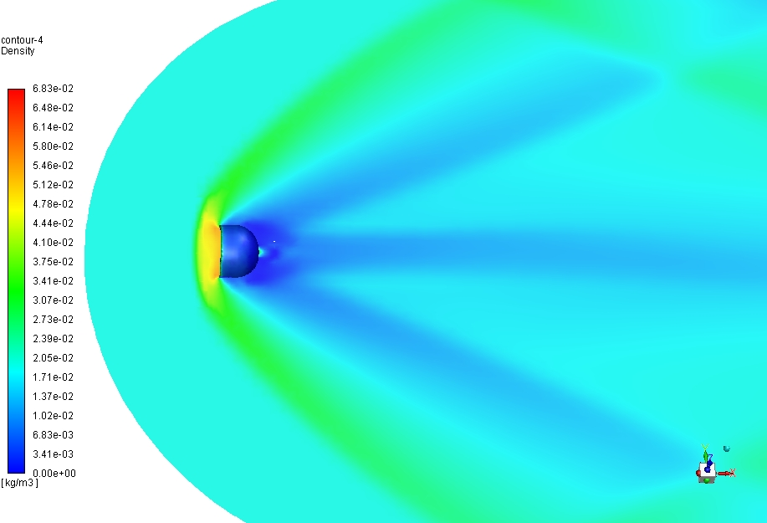
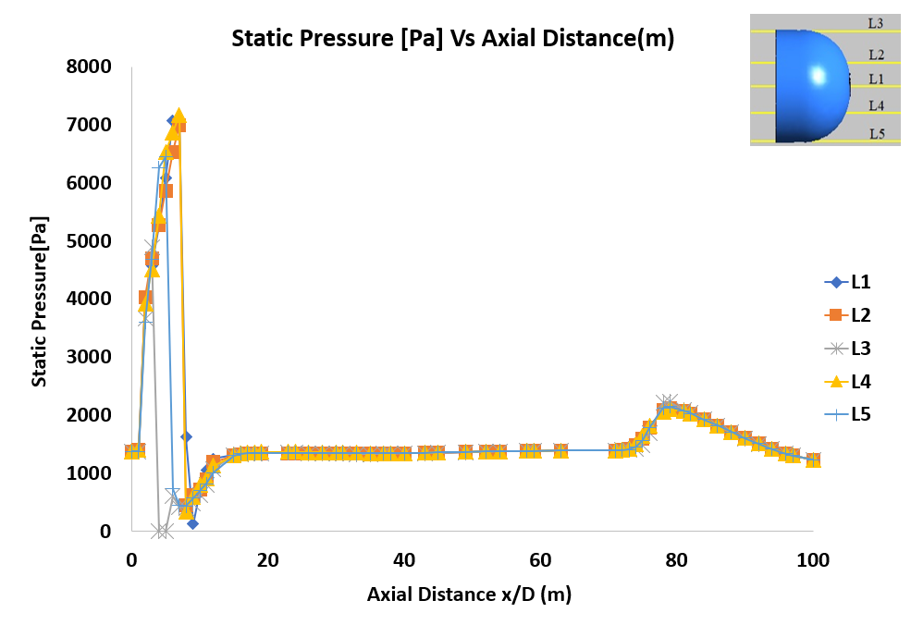
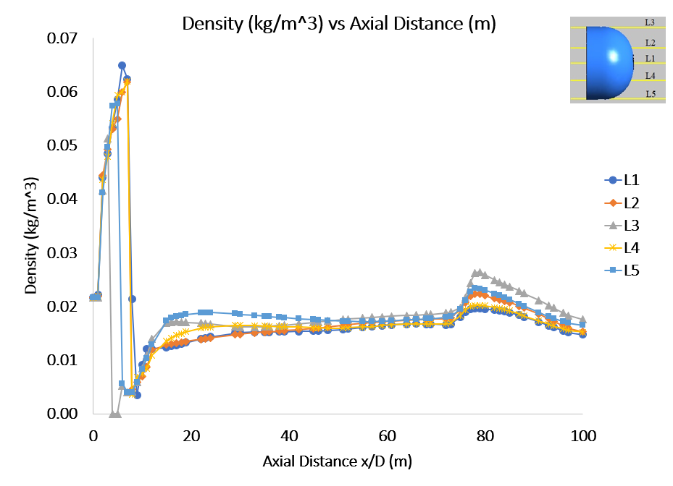
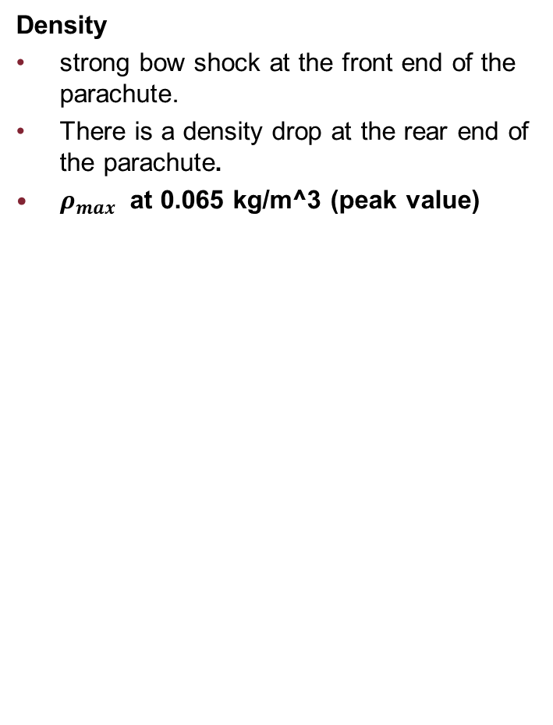
SCHIAPPARELLI PARACHUTE AT α=0°,M=2.04, H = 10km
Pressure
Bow shock wave at the 1m from front end of the parachute.
Immediate drop in the pressure at the sides and aft body of a parachute.
Pmax at 7100 Pa.
Density
strong bow shock at the front end of the parachute.
There is a density drop at the rear end of the parachute.
$ρ_{max}$ at 0.065 kg/m^3 (peak value)

Slide 13
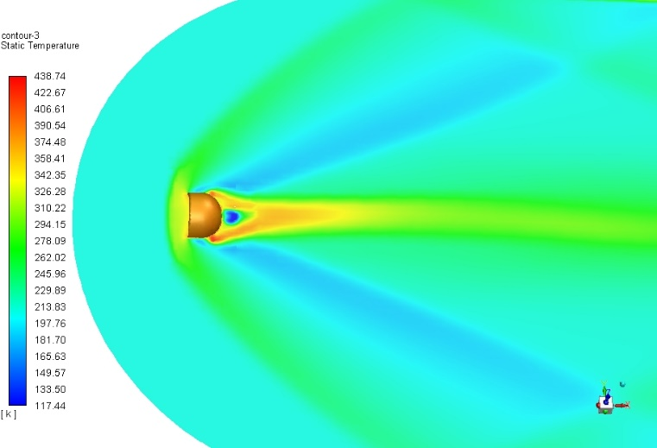
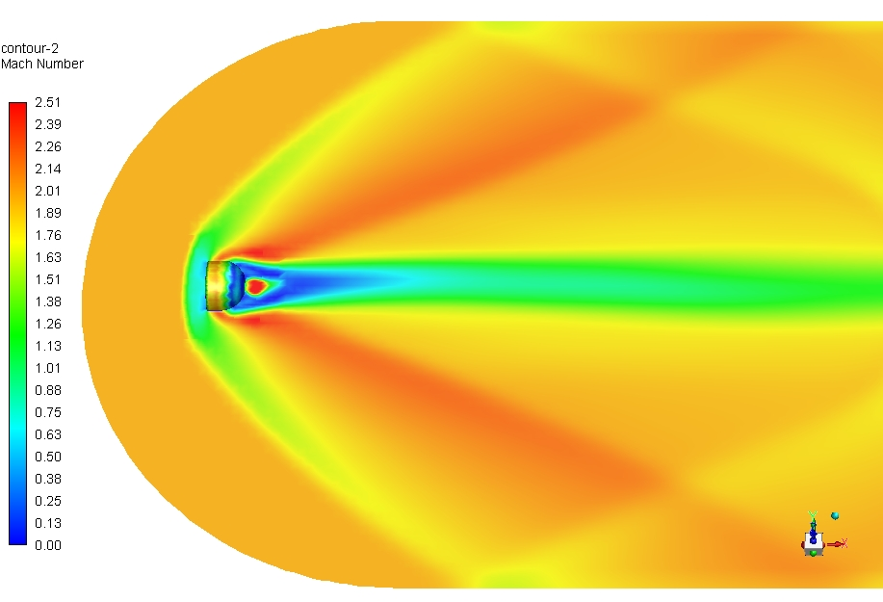
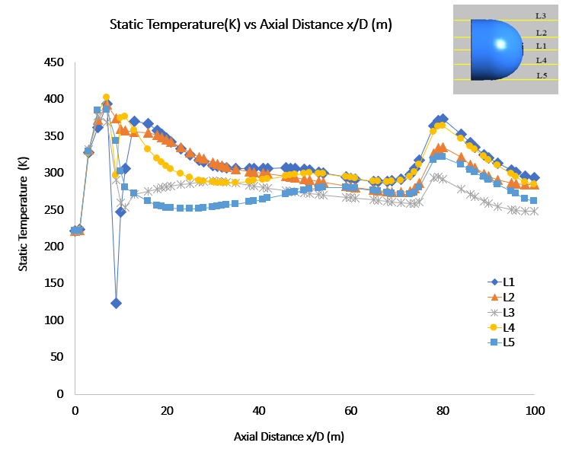
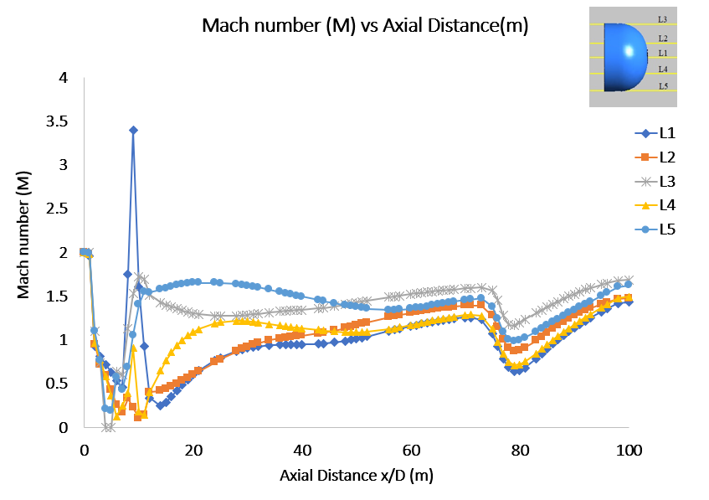
Temperature
Narrow shock layer at canopy.
Wider bow shock at front end of the parachute.
Tmax at 438.75K.
Mach Number
Bow shock at 1.2m form front end of parachute.
M =3.31(velocity (c) =139.58 m/s.

Slide 14
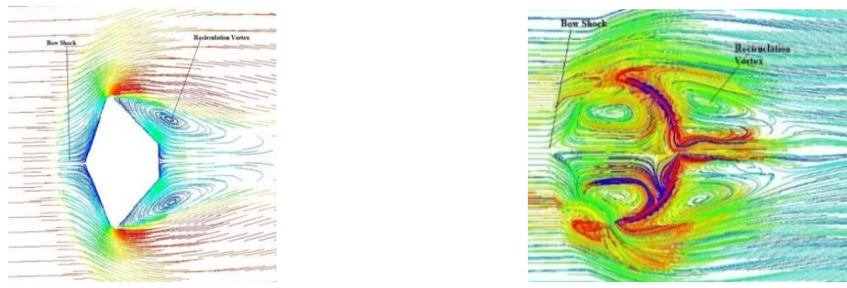
The Possible oscillating Regime
For the investigation of this anomaly,the possible oscillating regime is Low supersonic Regime.
An axi-symmetric vortex can be observed in the central region on the leeside of afterbody of the capsule and also at canopies front and back side in Low supersonic Regime.
Pressure flow field and vortex structure completely axisymmetric.
Now investigate the interaction between capsule and parachute (final Trajectory).

Slide 15
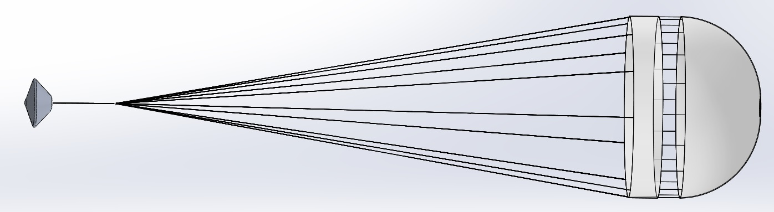
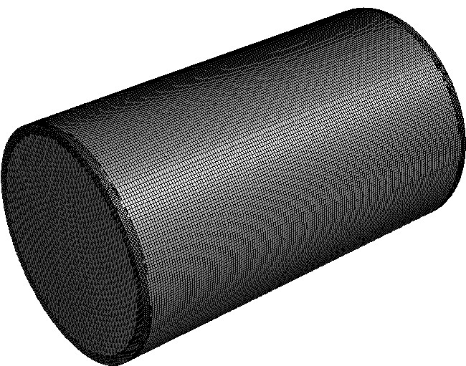
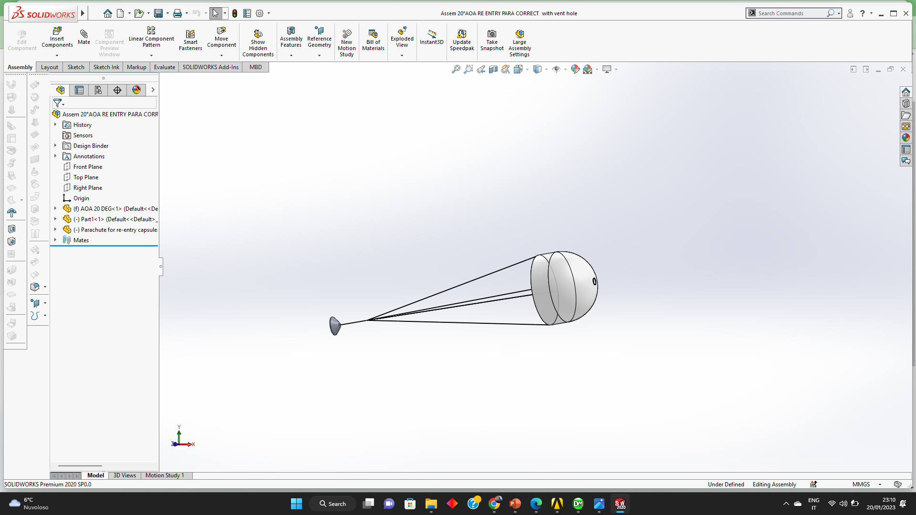
SIMULATION OF SCHIAPARELLI FINAL ALTITUDE AND TRAJECTORY
Design of Capsule with parachute at α = 0°
Design of Capsule with parachute at α = 20°
Meshing: cut-cell method (for Structured mesh)
No of cells: 1.1 million ;Domain Length =100m
Mesh Details
Boundary conditions
Angle of Attack(α) | Mesh type | No. of Elements | No. of nodes
0° | Coarse | 308760 | 281767
 | Medium | 758489 | 737408
 | Fine | 1416103 | 1295970
20° | Coarse | 281767 | 307860
 | Medium | 737408 | 758489
 | Fine | 1163920 | 1111666
Zone | Boundary | Parameters
Inlet | Pressure Far Field | At Altitude 10km, Pressure (p) = 254.54 Pa Velocity (v)=228.5m/s Temperature (T)=205K Mach number(M)=2.04814
Wall | Wall | -

Slide 16
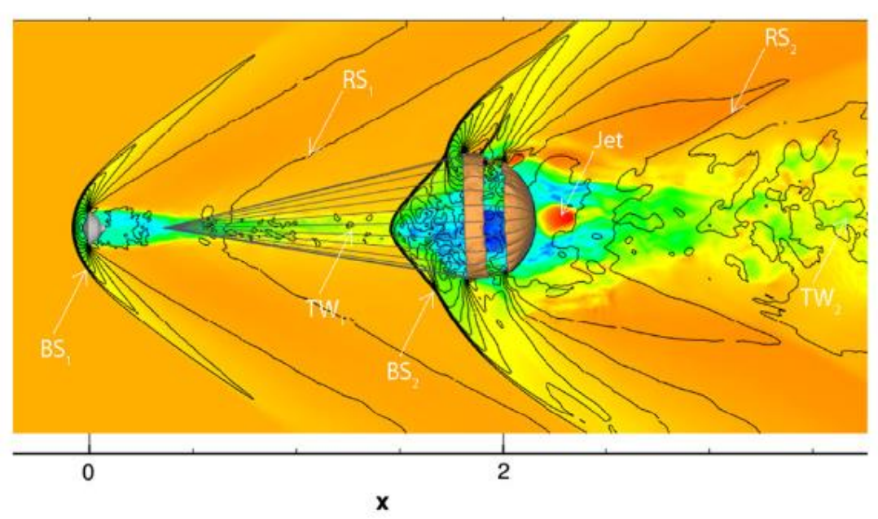
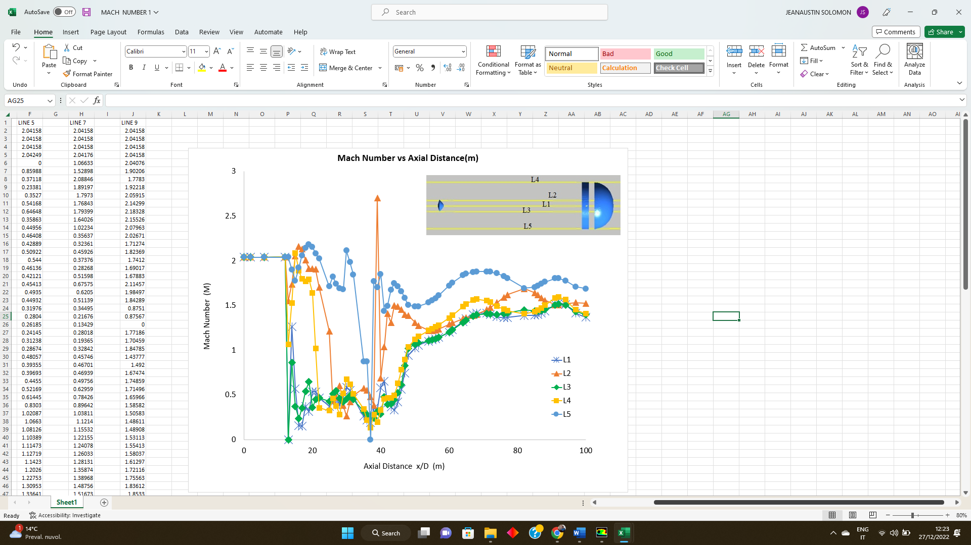
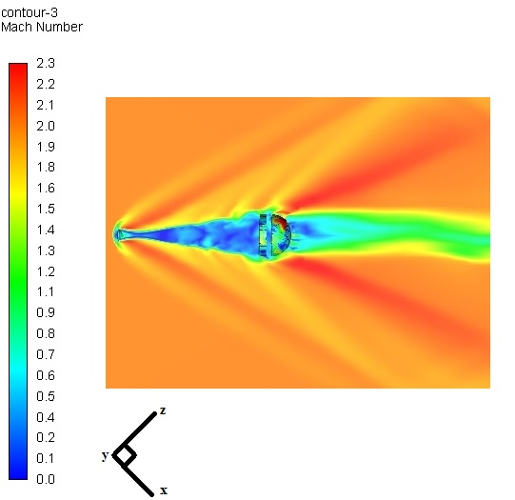
SCHIAPARELLI FINAL ALTITUDE AND TRAJECTORY H= 10KM,α= 0°,M=2.04814
General flow features around the interacting surfaces.
Mach number
Interaction between the region of the shock wake downstream of the capsule and the parachute.
Turbulent wave (TW2) interaction at backside of the canopy.
Max M = 2.7 (V=173.7m/s)

Slide 17
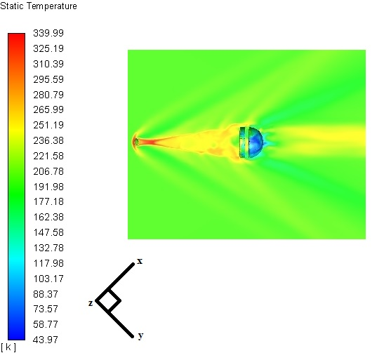
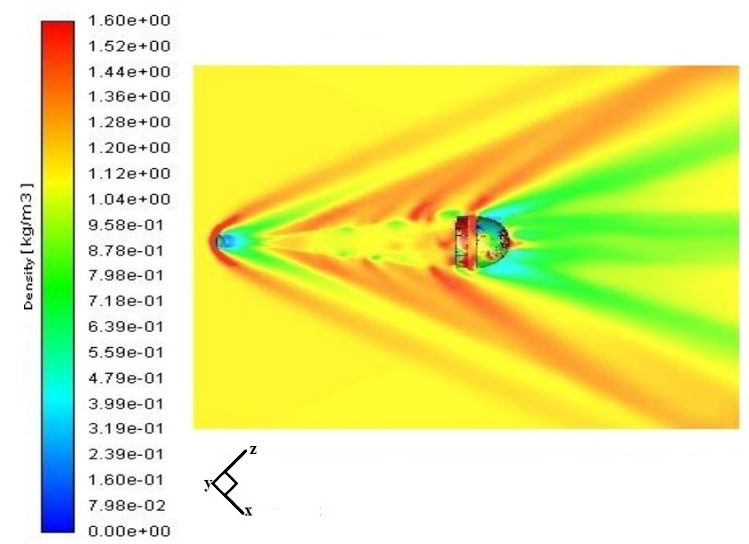
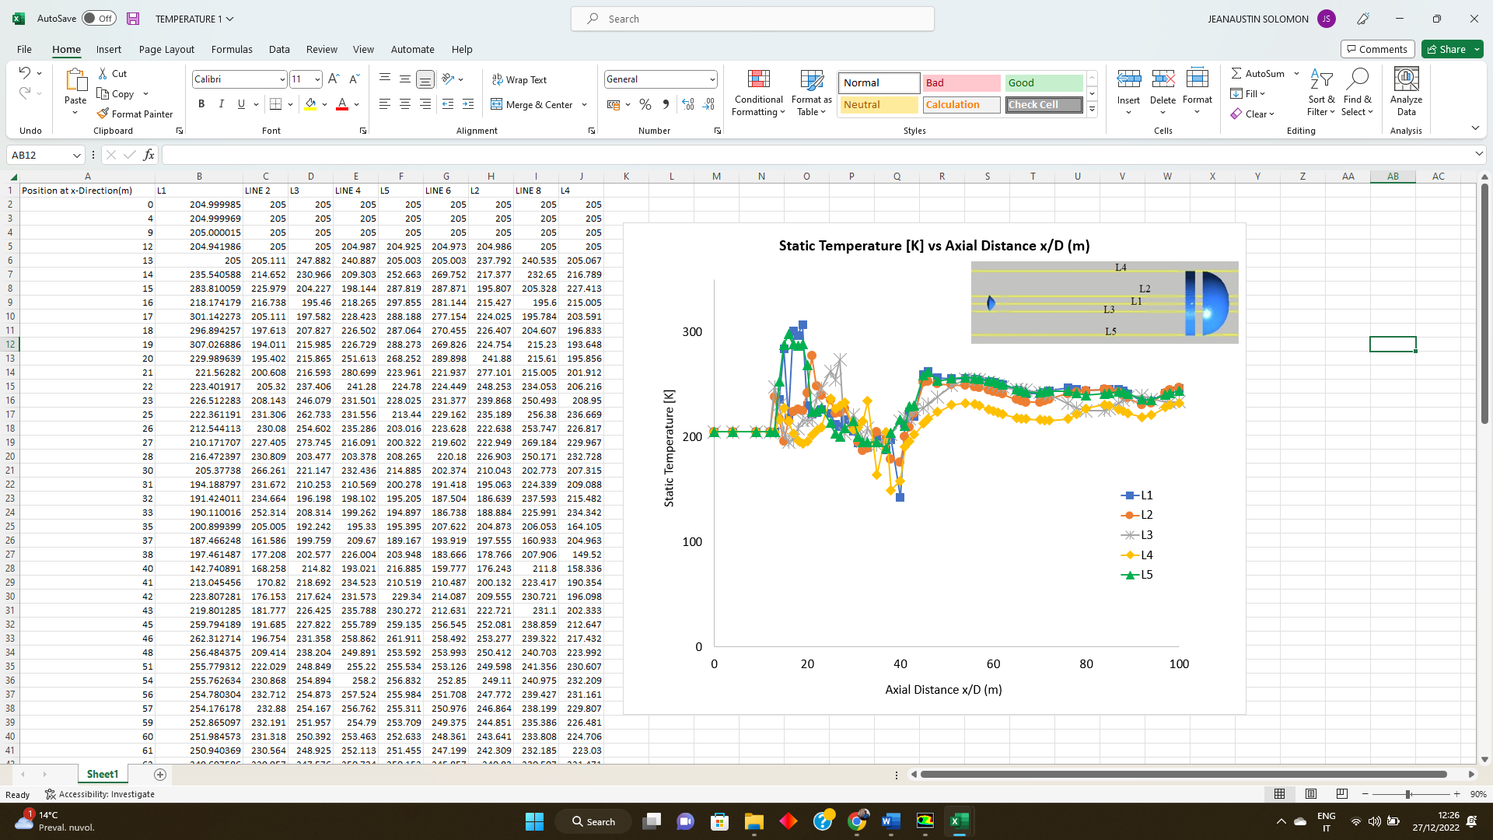
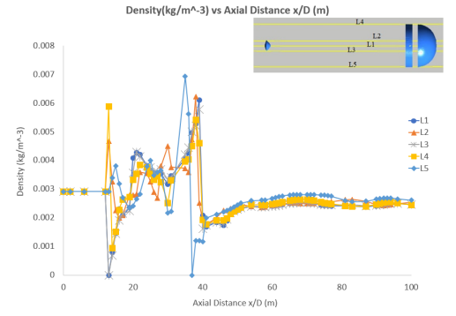
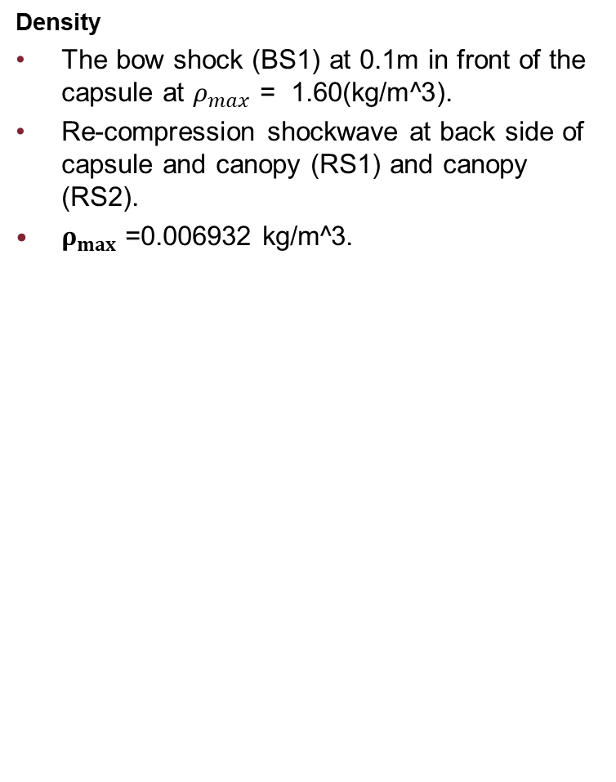
Temperature
strong bow shock (BS1) at 0.1m in front end of the capsule.
Turbulent wake between the capsule and canopy (TW1) and also in the backside of canopy (TW2).
Tmax at 339.99K.
Density
The bow shock (BS1) at 0.1m in front of the capsule at $ρ_{max}$ = 1.60(kg/m^3).
Re-compression shockwave at back side of capsule and canopy (RS1) and canopy (RS2).
$ρ_{max}$ =0.006932 kg/m^3.

Slide 18
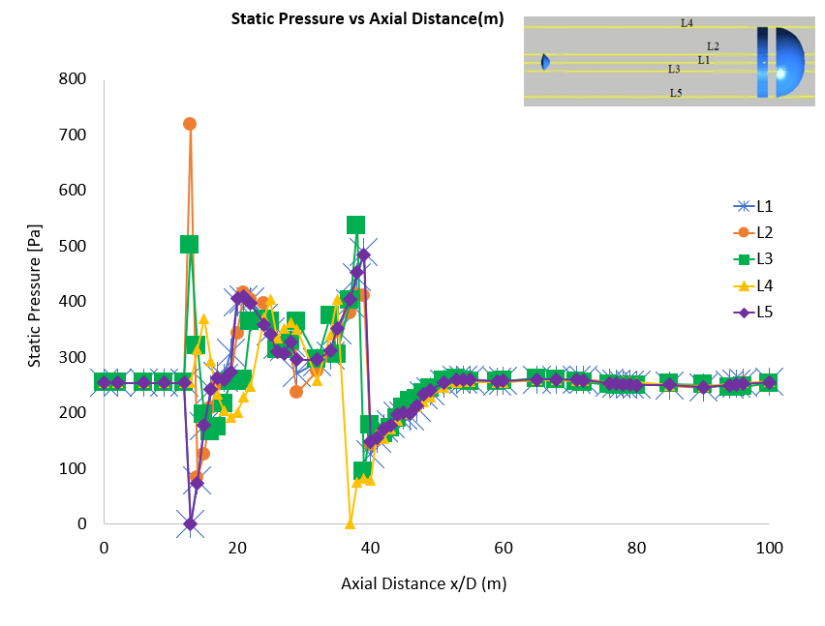
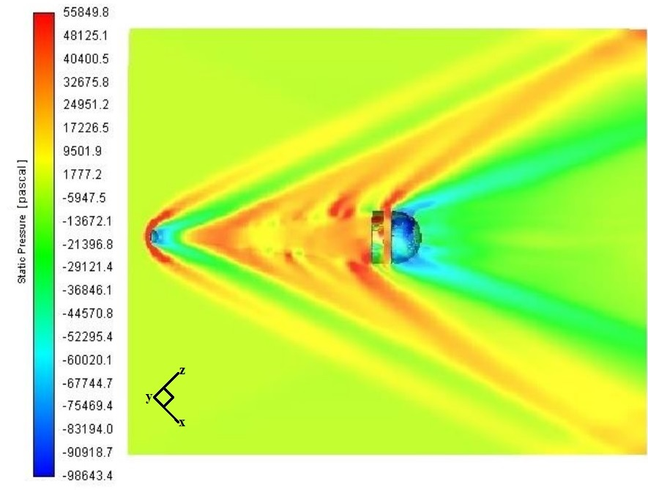
Pressure
Strong bow shock at 0.1m in front end of Re-Entry Capsule.
Pmax = 720pa
Pressure is not axisymmetric due to the interruption between turbulence at downstream of capsule and shockwaves at upstream of the parachute.
→this triggers oscillation

Slide 19




SCHIAPARELLI FINAL ALTITUDE AND TRAJECTORY at H= 10KM,α= 0°,M=2.04814
CO2 Mass fraction
N2 Mass fraction
Flow is nearly chemical equilibrium and at afterbody of the capsule
Turbulent wake (TW₁) between capsule and canopy and also at back side of Parachute (TW₂) .

Slide 20


SCHIAPARELLI FINAL ALTITUDE AND TRAJECTORY at H= 10KM,α= 0°,M=2.04814
Ar Mass fraction
The Re compression shock wave(RS2) arises at backside of the canopy.
Maximum mass fraction is 0.065.
The bow shock is not at front end of the capsule and canopy, In real gas model .
wake shock interaction at distance of 27631mm between capsule and canopy.
Now investigate the simulation fo α =20°

Slide 21





SCHIAPARELLI FINAL ALTITUDE AND TRAJECTORY at H= 10KM,α= 20°,M=2.04814
Pressure
The strong bow shock at 0.4m form front end of Re-entry Capsule (BS1) and at 0.8m form front end of the parachute (BS2).
Pmax =1688.61Pa (from L5).
Density
Bow shock at 0.45m from the front end of Re-entry capsule.
Narrow Turbulent wake layer at aft body of capsule and canopy due to change in α .
$ρ_{max}$ at 0.020576 kg/m³ (from graph).

Slide 22




Temperature
Turbulent wakes (TW1 and TW 2) are formed at rear end of capsule and canopy.
Tmax at 8900K(from graph L5), Tmax =982 K (from contour);
Mach number
Strong bow shock in front end of the re-entry capsule and parachute .
The turbulent wake (TW₂) is narrower at backside of canopy at supersonic speed.
M max= 2.2 (velocity (c) = 1031.8m/s)

Slide 23




CO2 Mass fraction
N2 Mass fraction
Turbulent wake (TW1 )at aft-body of the capsule.
CO_{2,} N₂ Mass fraction become constant till from 44m to 100m in graph.
Turbulent wake (TW₂) region travels at cross path at aftbody of canopy .

Slide 24
Final Remarks
The present work made deals with an analysis of Schiaparelli Re-Entry anomaly on Mars. The pre-flight aerodynamic results generated by the TAS-I, the company in charge of the mission, were used together with a three-dimensional Navier-Stokes and Euler computational fluid dynamics simulations performed here. In particular, the supersonic flow field past the Schiaparelli capsule seems to be relevant to generate a potential asymmetry of the wake arriving to the parachute.
In the present analysis, only continuum regime (supersonic speed ranges) of the flow was modelled, both as ideal gas and reacting gas mixture. Engineering based analysis based on supersonic and transonic panel methods has been extensively used to rapidly develop a very preliminary capsule and canopy aerodynamic database.
The numerical computation has been done at various altitudes i.e., the ideal gas (at H=10km above mars) and reacting gas (at H = 20km and H = 50km above Mars) method of simulation is performed for Capsule and only the ideal gas (at H = 10km from mars) method is performed for Canopy at M=2.04 which follows supersonic regime.
The numerical investigation about final trajectory of Schiaparelli Capsule with Canopy in Aereal oscillations and Parachute deployment has undergone at H = 10km above Mars with α = 0° and 20°. This research follows the possible oscillating regime of supersonic between M=1.75 and M = 2.04 with the help of RANS and Large Eddy Simulations (LES) by using chemical transport.
Finally, numerical results show that ideal and real gas effects increase in the aerodynamic drag and Lift whereas the ballistic is only slighted influenced. Pressure flow filed is not axisymmetric due to formation of wake at downstream of the capsule and shockwaves at upstream of parachute which creates turbulence flow at the time of final trajectory. So, It is critical to find the interaction between wake of the capsule and canopy.
Moreover, several results comparisons highlight that experimental and CFD aerodynamic findings available for the Schiaparelli in Martian’s atmosphere adequately represent the static coefficients of the other space anomalies in the Mars atmosphere.

Slide 25
THANK YOU

